Slide 1
Dispatcher Wellness
Megan Healey
Emma Reilly

Slide 2
Introduction
Stress & its impacts
Dispatcher Implications
Self-Care & Coping Skills
Hypervigilance
Resilience
Western Mass CISM Team & Resources

Slide 3
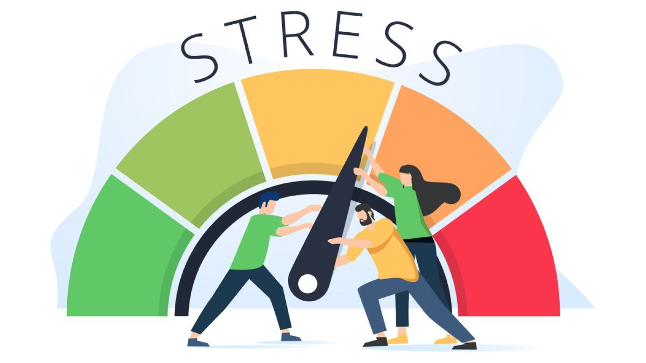
Stress
Stressor: Anything that activates the stress response in your body:
• External: work, money, family, cultural norms, discrimination
• Internal: self-criticism, body image, identity, memories
Stress:
Definition 1: A normal physical response to demands or perceived threats.
Definition 2: The neurological and physiological shift that happens in your body when you encounter a stressor.
Critical Incident Stress: A range of physical and psychological symptoms that might be experienced as a result of being involved in a traumatic incident.

Slide 4
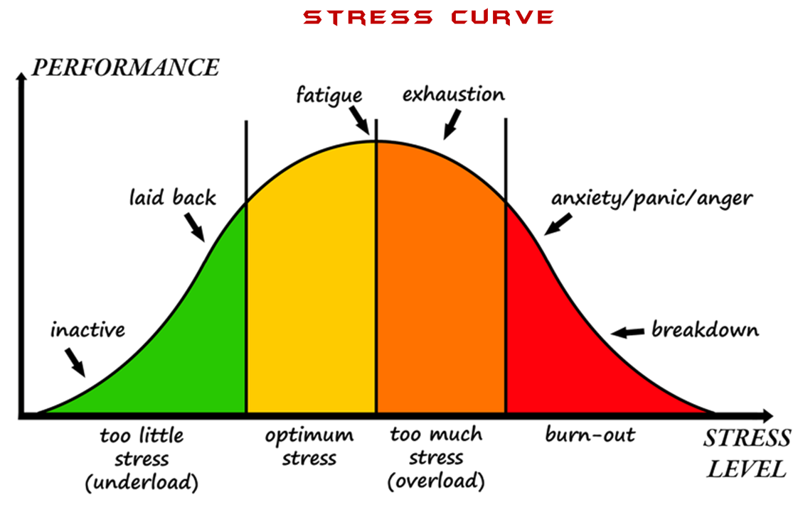
Stress Curve

Slide 5
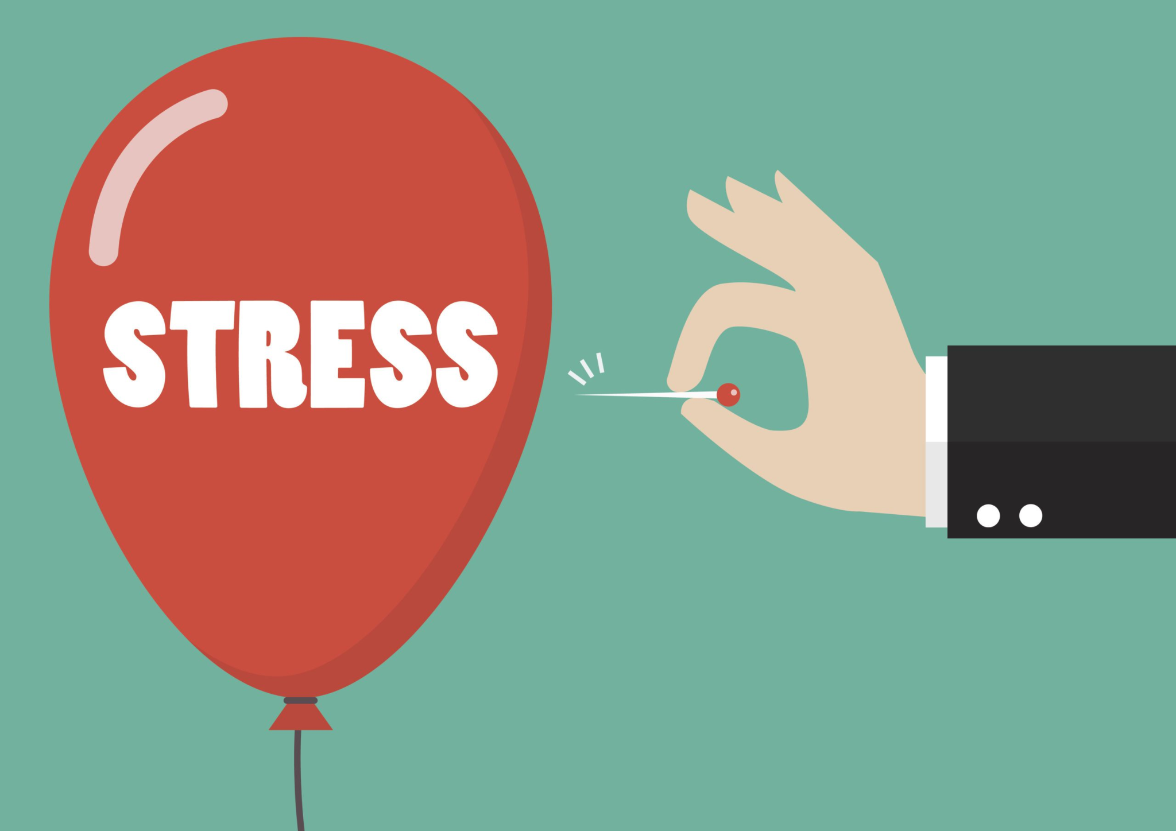
Impacts of Stress
Body:
Fatigue
Headaches
Taut muscles
Skin irritations
Frequent infections
Constricted breathing
Mind:
Worrying
Indecision
Negativity
Foggy thinking
Hasty decisions
Impaired judgement
Poor concentration
Nightmares
Hypervigilance
Emotions:
Loss of confidence
Apprehension
Indifference
Depression
Irritability
Anxiety
Behaviors:
Substance use
Loss of appetite
Accident prone
Restlessness
Loneliness
Insomnia

Slide 6
Implications of Stress in Dispatch
Mental Health Challenges:
Higher incidence of anxiety and depression.
Increased likelihood of post-traumatic stress disorder (PTSD).
Development of burnout syndrome.
Difficulty in concentrating and making decisions.
Physical Health Issues:
Increased risk of cardiovascular diseases.
Elevated blood pressure.
Chronic fatigue and insomnia.
Gastrointestinal problems.
Job Performance:
Reduced accuracy and efficiency in call handling.
Increased likelihood of errors and omissions.
Decreased ability to multitask and manage high-pressure situations.
Slower response times and impaired judgment.
Compassion fatigue.

Slide 7
Interpersonal Relationships:
Strained relationships with colleagues and supervisors.
Increased irritability and mood swings.
Social withdrawal and isolation from friends and family.
Difficulty in communicating effectively under pressure.
Long-term Career Implications:
Potential for early retirement due to health issues.
Career advancement may be hindered by chronic stress effects.
Possible impact on long-term career satisfaction and longevity.
Workplace Dynamics:
Higher rates of absenteeism and turnover.
Lower overall job satisfaction and morale.
Increased conflicts and tension within the team.
Need for more frequent breaks and time off to manage stress.

Slide 8
Training and Support Needs
Greater need for ongoing stress management and resilience training.
Increased demand for mental health resources and support services.
Implementation of regular debriefing sessions and counseling.
Development of peer support networks and wellness programs

Slide 9
Self-Care & Coping Skills
Self-Care = Proactive, preventative, developed over time
Helps increase quality of life.
Decreases distress and burnout.
Adequate sleep
Good nutrition
Regular physical activity
Connecting with others
Journaling (gratitude)
Meditation
Coping Skills = Reactive, applied in real time
Activities or tactics that can be used to decrease the current stress of a specific situation.
Deep breathing
Grounding techniques (5 senses)
Distraction (music, books, movies, etc.)
Spend time outdoors
Mindfulness
Journaling

Slide 10
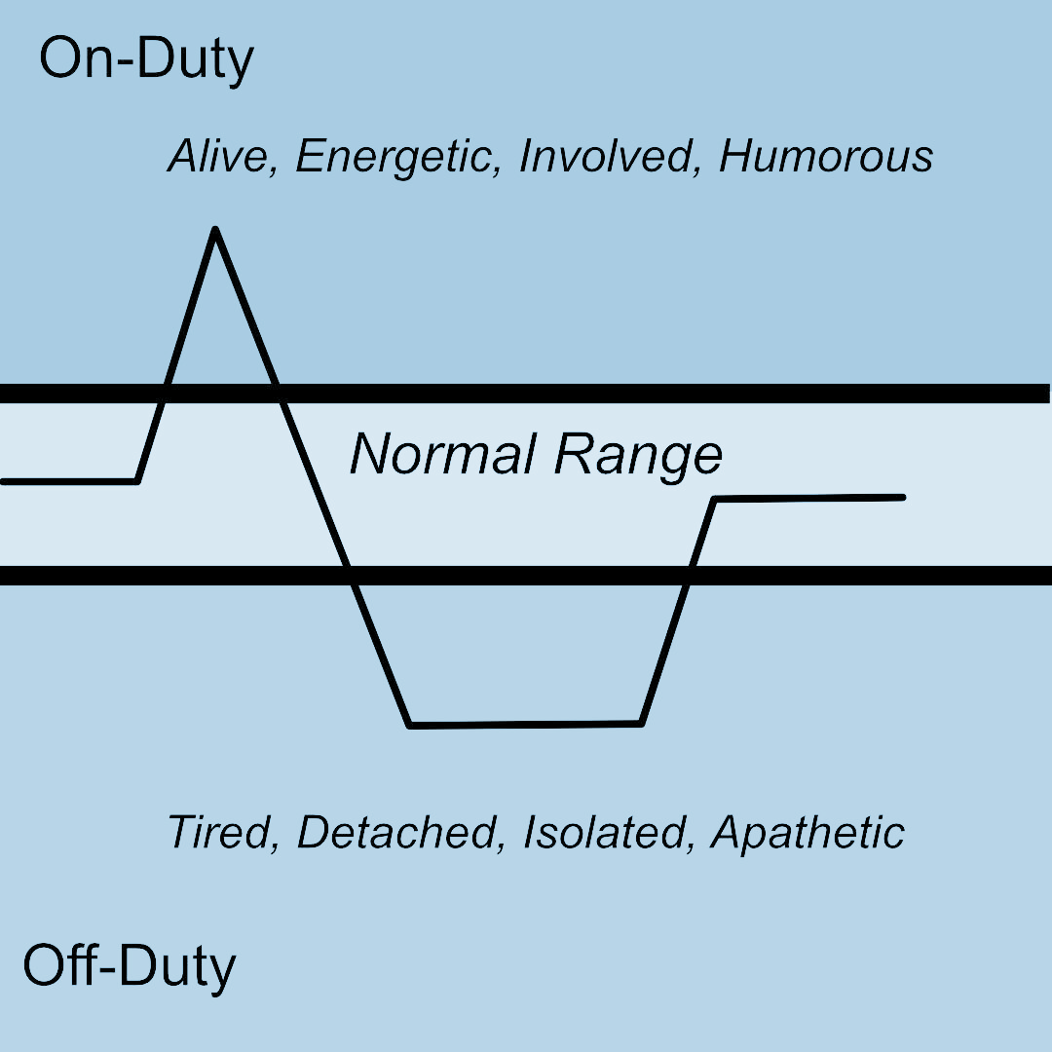
Hypervigilance
Extreme or excessive vigilance: the state of being highly or abnormally alert to
potential danger.
On-Duty:
Increased awareness
Elevated sense of attention
More rapid thinking
Increased capacity to make quick decisions
Feel alive, involved, and engaged
Sense of camaraderie with other first responders
Off-Duty:
Detached
Withdrawn, Isolated
Tired, Exhausted
Apathetic
Angry
–Gilmartin, 2021

Slide 11
How to Combat Hypervigilance
Self-corrects after 18-24 hours
20 Minutes of Moderate Exercise every day
Focus on what you can control (personal life)
Schedule activities & make plans BEFORE you’re at the bottom of the rollercoaster
Make time for enjoyable, non-work activities
Focus on what you can do NOW, not what you’ll do when you retire
Practice sleep hygiene whenever possible

Slide 12
Resilience
Factors that contribute to resilience:
• Good social supports
• Belief in recovery or getting through the hard times
• A sense of purpose in life/one’s roles
• Meaningful activities
• Engagement in therapy

Slide 13
The Role of the Western Mass CISM Team
Who we are:
Trained peer mentors from fire, police, EMS, and dispatch, as well as religious and clinical support.
What we do:
Provide interventions to first responders who have experienced a critical incident.
Group debriefings & one-on-one peer support
How this helps:
The process can provide answers (fills in the puzzle pieces) as to what happened in an incident.
Provides education on the warning signs of negative stress responses.
Shows support to your fellow first responders.

Slide 14
Resources
Western Mass CISM Team:
Call (413) 586-6065. Available 24 hours a day, 7 days a week. If after business hours, please press "1" and leave a message. Your call will be returned as soon as possible. For groups and individuals.
Commonwealth 911 Peer Support:
911 for 911! 24 hour hotline - call (840) 600-PEER (7337).
On Site Academy @ Windy Hill Farm, Westminster, MA
A short term, intensive residential treatment center for rescue personnel (dispatchers, EMS, firefighters, police officers) who may be temporarily overwhelmed by the stress of their job, suffering from work-related cumulative or delayed critical incident stress, or experiencing an acute, transient reaction to a “critical incident”.
Also offer non-residential services for loved one affected by and/or concerned about a first responder’s career and/or symptoms.

